Slide 1
Lecture # 6

Slide 2
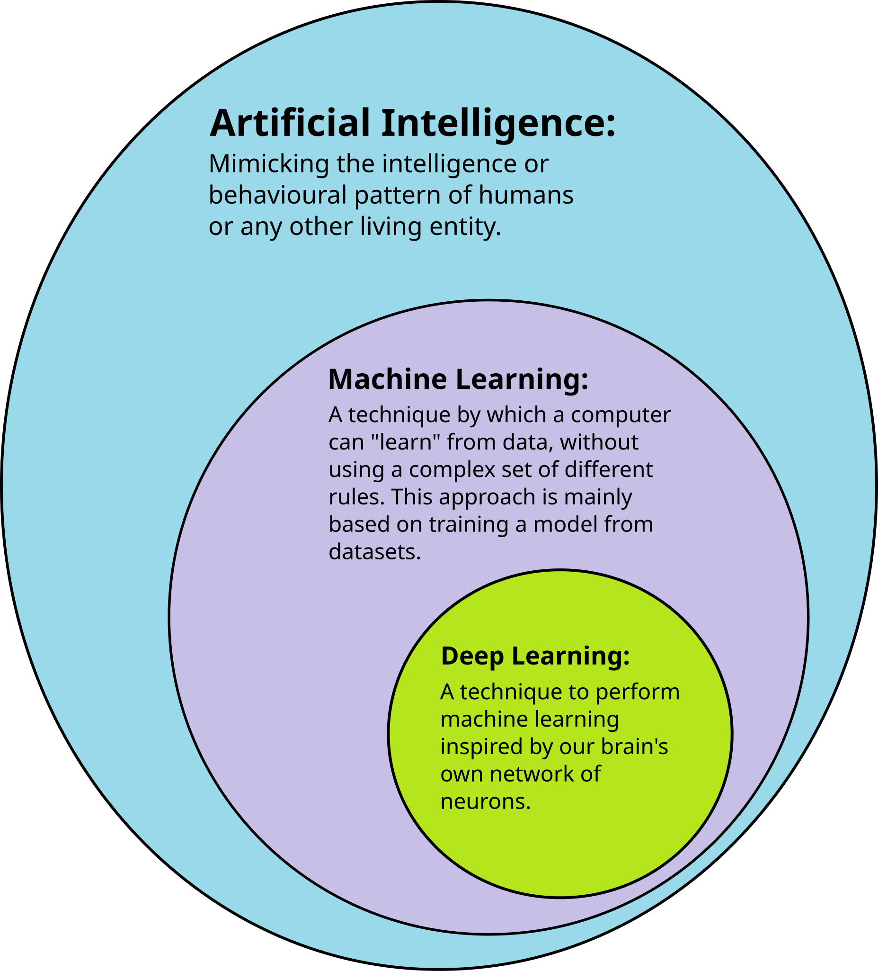
Introduction to Machine Learning

Slide 3

Introduction to Machine Learning
• Machine Learning (ML) is a field of Artificial Intelligence that enables computers to learn from data without being explicitly programmed.
• Instead of writing rules, the system finds patterns from data and makes decisions.
• The more data it learns from, the better its performance becomes.

Slide 4
What is Machine Learning?
• Machine Learning is teaching computers to learn from data
• Instead of programming every rule, we let the computer find patterns
Think of it like this:
• Traditional: You teach a child every single rule
• ML: You show examples and let them figure out the pattern
Example:
• Show 1000 cat photos → Computer learns what a cat looks like

Slide 5
Traditional Programming vs Machine Learning
Traditional Programming:
Input + Rules → Output
Example:
• Input: Number
• Rule: If number > 0, output 'Positive'
• Output: 'Positive' or 'Negative'
Limitations:
• Need to write all rules
• Can't handle complex patterns
• Hard to update
Machine Learning:
Input + Output → Rules
Example:
• Input: 1000 cat photos
• Output: Labels (cat/not cat)
• ML finds the rules automatically
Advantages:
• Learns from examples
• Handles complex patterns
• Improves with more data

Slide 6
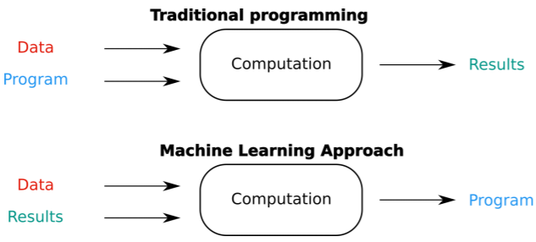
Traditional Programming Vs ML

Slide 7



Why do we need Machine Learning?
Machine Learning means teaching computers by examples, not by rules.
1. Pattern Recognition
• Recognizing faces in photos
• Understanding speech
No fixed rules, so ML learns from examples
2. Too Many Rules
• Email spam: Rules change constantly
• Stock market: Millions of factors
Rules change, ML adapts automatically
3. Personalization
• Netflix recommendations
• YouTube video suggestions
Different users get different results

Slide 8
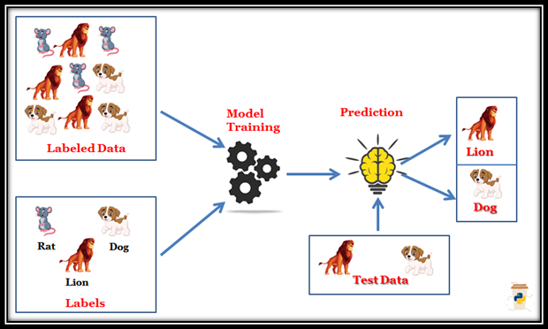
Types of Machine Learning
1. Supervised Learning
It is a type of Machine Learning where the model is trained using labeled data. The model learns the relationship between input and output and then makes predictions on new data. It has two types: classification and regression.
Learning with labeled examples
Like learning with answer key

Slide 9
Supervised Learning
• We provide labeled training data
• Model learns the relationship
• Then predicts on new data
Examples:
• Images: Cat, Dog, or Bird
• Grades: Predict student performance
Two types:
• Classification: Categories (spam/not spam)
• Regression: Numbers (house price, temperature)
Predict Pass / Fail ➝
Predict Marks out of 100 ➝
Predict House Price ➝
Predict Spam / Not Spam ➝

Slide 10
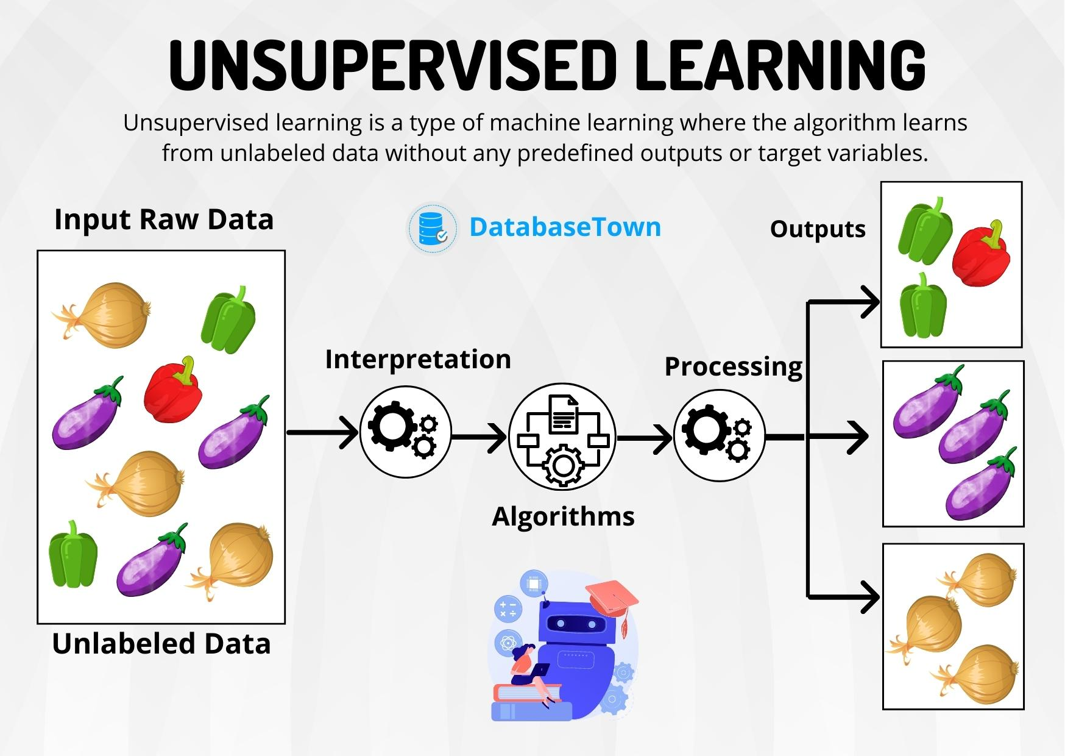
Types of Machine Learning
2. Unsupervised Learning is a type of Machine Learning where no labeled data is provided. The model finds hidden patterns and structure in data.
Unsupervised learning finds hidden patterns and often groups similar data points without using labels
Finding patterns in unlabeled data
Like exploring without a map

Slide 11
Unsupervised Learning
An online store has thousands of customers but no labels like “cheap buyer” or “premium buyer”.
What ML does:
Looks at buying frequency
Looks at money spent
Looks at product types
Result:
Group 1: High spenders
Group 2: Budget buyers
Group 3: Occasional buyers
Students with different learning styles.
What ML does:
Groups students by performance, speed, and behavior
No labels like “good” or “weak”
Result:
Fast learners
Average learners
Needs-help learners

Slide 12
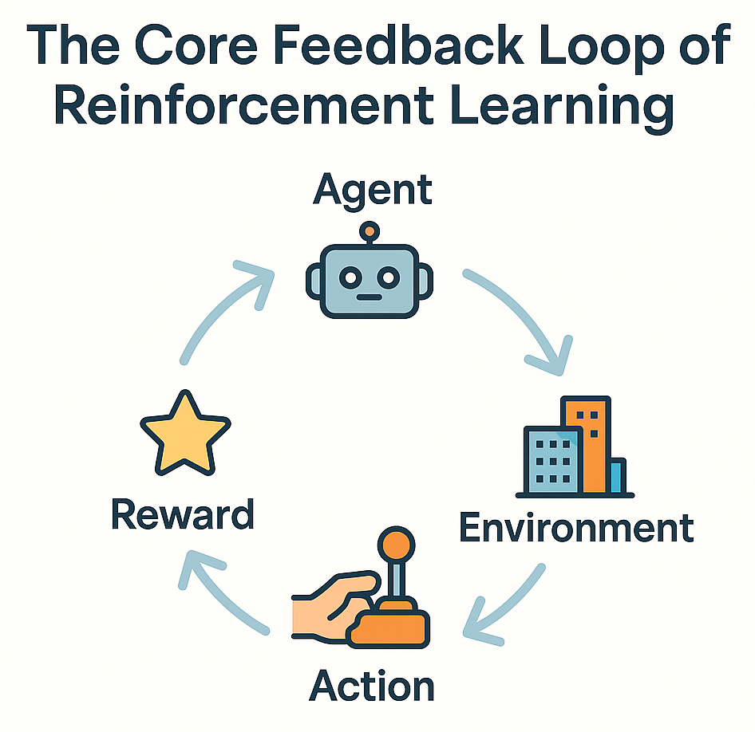
Types of Machine Learning
3. Reinforcement Learning is a type of Machine Learning where an agent learns by interacting with the environment. It receives rewards for good actions and penalties for bad actions. Over time, it learns the best actions to achieve its goal.
Reinforcement Learning = Learn by trying, get rewards or penalties, improve over time.
Learning through trial and error
Like learning to ride a bike

Slide 13
Reinforcement Learning
Definition:
• Agent learns by interacting with environment
• Gets rewards for good actions
• Gets penalties for bad actions
Real-world examples:
• Game playing (Chess, Go)
→ Learn winning strategies
• Robot navigation
→ Learn to avoid obstacles
• Recommendation systems
→ Learn what users like
Key concept:
• Trial and error with feedback

Slide 14
Real-world Example: Email Spam Detection
Problem:
• Millions of emails daily
• Spam changes constantly
• Can't write rules for everything
ML Solution:
• Train on thousands of emails
• Learn patterns:
- Words like 'FREE', 'WIN', 'URGENT'
- Suspicious sender addresses
- Unusual formatting
• Classify new emails automatically
Result:
• Gmail filters 99.9% of spam automatically

Slide 15
Real-world Example: Face Recognition
Problem:
• Identify people in photos
• Used in:
- Phone unlock
- Security systems
ML Solution:
• Train on millions of face images
• Learn facial features:
- Eye shape, nose, mouth position
- Face structure patterns
Result:
• Recognize faces in new photos

Slide 16
Real-world Example: Recommendation Systems
Netflix & YouTube:
• Problem: Too many videos to choose from
• Solution: Recommend what you might like
How it works:
• Track what you watch
• Find users with similar tastes
• Recommend what they liked
Example:
• You watched: Action movies
• Similar users also watched: Sci-fi
• Recommendation: Try 'Interstellar'
Result:
• 80% of Netflix views come from recommendations

Slide 17
Machine Learning Workflow
1. Data Collection
• Gather examples (photos, text, numbers)
2. Data Preprocessing
• Clean and organize data
• Remove errors and duplicates
3. Feature Extraction
• Convert raw data into features
4. Model Training
• Teach the model using data
5. Evaluation
• Test on new data
• Measure accuracy
6. Prediction
• Use model for real predictions

Slide 18
Common Machine Learning Applications
In Daily Life:
• Virtual assistants (Siri, Alexa)
• Social media feeds (Facebook, Instagram)
• Online shopping (Amazon recommendations)
• Navigation (Google Maps route optimization)
In Industry:
• Healthcare: Disease diagnosis
• Finance: Fraud detection
• Transportation: Self-driving cars
• Education: Personalized learning
In Research:
• Drug discovery
• Climate prediction
• Language translation

Slide 19
Key Takeaways
What we learned:
✓ Machine Learning = Learning from data
✓ Three types: Supervised, Unsupervised, Reinforcement
✓ Used everywhere: Email, photos, recommendations
✓ Workflow: Data → Features → Model → Prediction
Next:
→ How to extract features from data
→ How classification works
→ Practical examples

Slide 20
Feature Extraction & Classification

Slide 21
What is Data?
Data is anything that we can record, store, or analyze.
1. Images
• Photos, drawings, screenshots
• Example: Cat photo, student ID card
2. Text
• Emails, articles, messages
• Example: 'This is a great course!'
3. Numbers
• Measurements, scores, prices
• Example: Student grades, temperature
4. Mixed
• Combination of above
• Example: Student profile (name, photo, grades)

Slide 22
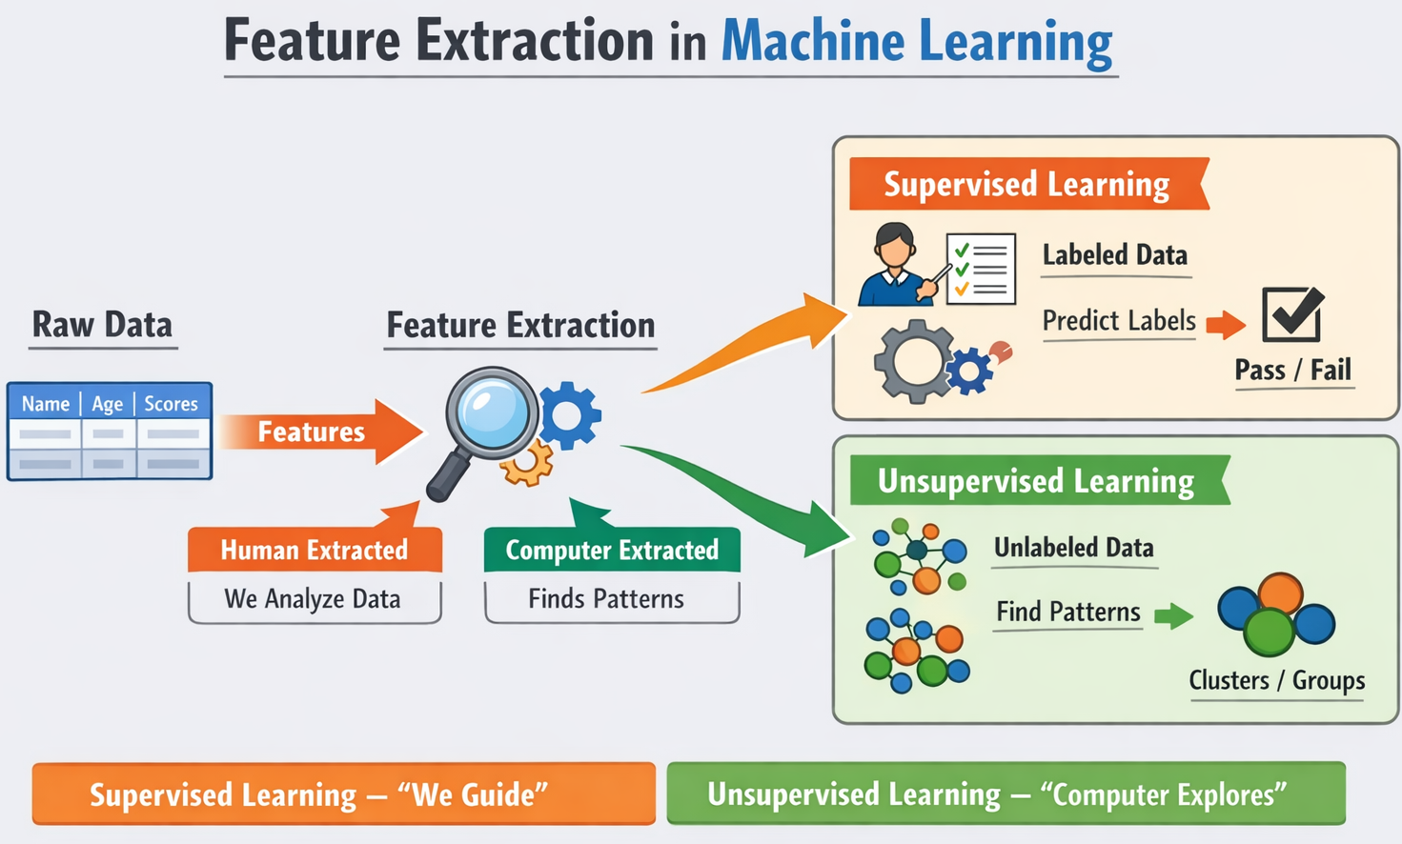
What are Features?
Features = Characteristics that describe data
Simple analogy:
• Describing a student:
- Height (number)
- Hair color (category)
- Grade average (number)
In ML:
• Features help the model understand data
• Good features = Better predictions
Example - Image of a cat:
• Raw: Millions of pixels
• Features:
- Has pointy ears? (Yes/No)
- Has whiskers? (Yes/No)
- Color: Orange, Black, White
- Size: Small, Medium, Large

Slide 23
Why Feature Extraction is Important?
Problem with raw data:
• Too much information
• Irrelevant details
• Hard for computer to understand
Solution - Feature extraction:
• Focus on important characteristics
• Reduce complexity
• Make patterns easier to find
Example - Student photo:
• Raw: 1000x1000 pixels = 1 million numbers
• Features:
- Face shape: Round
- Eye color: Brown
- Hair: Long, Black
- Expression: Smiling
• Result: Just 4-5 meaningful features!

Slide 24
What is Classification?
Classification = Putting data into categories
Simple analogy:
• Sorting fruits into baskets
• Apple → Fruit basket
• Carrot → Vegetable basket
In ML:
• Input: Data with features
• Output: Category/Class
Example:
• Input: Email with features
- Has 'free' (Yes)
- Has '!!!' (Yes)
- From unknown sender (Yes)
• Output: Spam
Goal:
• Learn patterns from examples
• Classify new data correctly

Slide 25
Binary vs Multi-class Classification
Binary Classification:
Two categories only:
• Yes/No
• Spam/Not Spam
• Pass/Fail
• Sick/Healthy
Example:
• Email → Spam or Not Spam?
Simpler problem:
• Just two choices
• Easier to understand
Multi-class Classification:
More than two categories:
• Cat/Dog/Bird
• Grade: A/B/C/D/F
• Emotion: Happy/Sad/Angry
Example:
• Image → Cat, Dog, or Bird?
More complex:
• Multiple choices
• Need more training data

Slide 26
Classification Example: Spam Detection
Problem:
• Classify emails as Spam or Not Spam
Step 1: Extract Features
• Word 'free' appears? (Yes/No)
• Word 'win' appears? (Yes/No)
• Many exclamation marks? (Yes/No)
• From known sender? (Yes/No)
Step 2: Train Classifier
• Show 1000 spam emails
• Show 1000 normal emails
• Learn patterns
Step 3: Classify New Email
• Extract features
• Compare with learned patterns
• Output: Spam or Not Spam
Result:
• 99%+ accuracy in real systems

Slide 27
Classification Example: Disease Detection
Problem:
• Detect disease from symptoms
Features:
• Fever? (Yes/No)
• Cough? (Yes/No)
• Temperature: 38.5°C
• Age: 25 years
Classification:
• Input: Patient symptoms
• Output: Disease category
- Fever
- Flu
- COVID-19
- Healthy
Real application:
• Assist doctors in diagnosis
• Early detection saves lives

Slide 28
Common Classifiers (High-Level Overview)
Three popular classifiers:
1. K-Nearest Neighbors (KNN)
• Find similar examples
• Vote by majority
• Like asking neighbors for advice
2. Decision Tree
• Ask yes/no questions
• Follow path to answer
• Like a flowchart
3. Logistic Regression
• Find best line/curve to separate classes
• Uses probability
• Like drawing a boundary

Slide 29
K-Nearest Neighbors (KNN) - Intuition
How it works (simple explanation):
1. Store all training examples
2. For new data:
• Find K nearest neighbors
• K = number of neighbors (e.g., K=3)
3. Vote:
• Look at neighbors' labels
• Majority wins
Example:
• New email: Is it spam?
• Find 3 most similar emails
• 2 are spam, 1 is not
• Decision: Spam (2 out of 3)
Analogy:
• Like asking your 3 closest friends for advice
[Visual Suggestion: Diagram: New point → Find K neighbors → Vote → Class]

Slide 30
Decision Tree
How it works:
• Series of yes/no questions
• Each answer leads to next question
• Final answer at the end
Example - Classifying email:
Question 1: Has word 'free'?
→ Yes: Go to Question 2
→ No: Go to Question 3
Question 2: From unknown sender?
→ Yes: SPAM
→ No: Go to Question 3
Question 3: Has many '!'?
→ Yes: SPAM
→ No: NOT SPAM
Visual:
• Like a tree with branches
• Each branch = a decision
[Visual Suggestion: Tree diagram: Root → Branches → Leaves (classes)]

Slide 31
Logistic Regression (Concept Only)
High-level idea:
• Draw a line/curve to separate classes
• Find the best boundary
Example - Spam detection:
• Feature 1: Number of 'free' words
• Feature 2: Number of exclamation marks
• Draw line separating spam from not spam
How it works:
• Calculate probability
• If probability > 50% → Class 1
• If probability < 50% → Class 2
Visual:
• Like drawing a line on a graph
• Points on one side = Spam
• Points on other side = Not Spam
Note:
• We'll skip the math details
• Focus on the concept
[Visual Suggestion: Graph: Two classes separated by a curve/line]

Slide 32
End-to-End Example: Image Classification
Complete workflow:
Step 1: Input Image
• Photo of a cat
Step 2: Feature Extraction
• Extract: Pointy ears (Yes)
• Extract: Whiskers (Yes)
• Extract: Tail (Yes)
• Extract: Size (Small)
Step 3: Classification
• Input features to classifier
• Compare with learned patterns
Step 4: Output
• Prediction: Cat (95% confidence)
Real system:
• Processes in milliseconds
• Can handle thousands of images
[Visual Suggestion: Complete flowchart: Image → Features → Classifier → Output]

Slide 33
Student Example: Grade Prediction
Problem:
• Predict if student will pass or fail
Features:
• Attendance: 85%
• Assignment average: 78
• Midterm score: 82
• Study hours per week: 15
Classification:
• Input: Student features
• Output: Pass or Fail
How it helps:
• Identify at-risk students early
• Provide extra support
• Improve learning outcomes
Real application:
• Used in many universities
• Helps improve student success
[Visual Suggestion: Diagram: Student data → Features → Classifier → Pass/Fail]

Slide 34
Part 2: Key Takeaways
What we learned:
✓ Features = Important characteristics of data
✓ Feature extraction simplifies complex data
✓ Classification = Putting data into categories
✓ Binary (2 classes) vs Multi-class (many classes)
✓ Common classifiers: KNN, Decision Tree, Logistic Regression
Complete process:
Data → Feature Extraction → Classification → Prediction
Next steps:
→ Practice with real datasets
→ Try building your own classifier
→ Explore more ML topics
[Visual Suggestion: Summary diagram, checkmark icons]

Slide 35
Course Summary
Today we covered:
Part 1: Introduction to ML
• What is ML and why we need it
• Types: Supervised, Unsupervised, Reinforcement
• Real-world applications
• ML workflow
Part 2: Feature Extraction & Classification
• Understanding data and features
• Feature extraction methods
• Classification concepts
• Common classifiers
Key message:
ML is about learning patterns from data to make predictions
[Visual Suggestion: Summary diagram connecting all concepts]

Slide 36
Questions & Next Steps
Questions?
Recommended next topics:
• Model evaluation (accuracy, precision, recall)
• More classifiers (SVM, Random Forest)
• Deep Learning basics
• Practical projects
Resources:
• Practice with datasets (Kaggle, UCI)
• Try Python libraries (scikit-learn)
• Build simple projects
Thank you!
Remember:
• Start simple
• Practice regularly
• Learn by doing
[Visual Suggestion: Question mark icon, resource icons]

